Slide 1
Unsupervised learning
David Kauchak CS 451 – Fall 2013

Slide 2
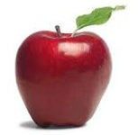
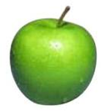
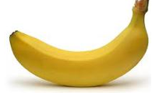
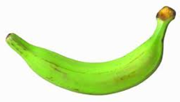
Supervised learning
label
label₁
model/
predictor
label₃
label₄
label₅
Supervised learning: given labeled examples

Slide 3
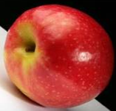
Unsupervised learning
Unsupervised learning: given data, i.e. examples, but no labels

Slide 4
Unsupervised learning
Given some example without labels, do something!

Slide 5
Unsupervised learning applications
learn clusters/groups without any label
customer segmentation (i.e. grouping)
image compression
bioinformatics: learn motifs
find important features
…

Slide 6
Unsupervised learning: clustering
Raw data
features
f₁, f₂, f₃, …, f_{n}
f₁, f₂, f₃, …, f_{n}
Clusters
f₁, f₂, f₃, …, f_{n}
f₁, f₂, f₃, …, f_{n}
group into classes/clusters
extract
features
f₁, f₂, f₃, …, f_{n}
No “supervision”, we’re only given data and want to find natural groupings

Slide 7
Unsupervised learning: modeling
Most frequently, when people think of unsupervised learning they think clustering
Another category: learning probabilities/parameters for models without supervision
Learn a translation dictionary
Learn a grammar for a language
Learn the social graph

Slide 8
Clustering
Clustering: the process of grouping a set of objects into classes of similar objects
Applications?

Slide 9
Gene expression data
Data from Garber et al.
PNAS (98), 2001.

Slide 10
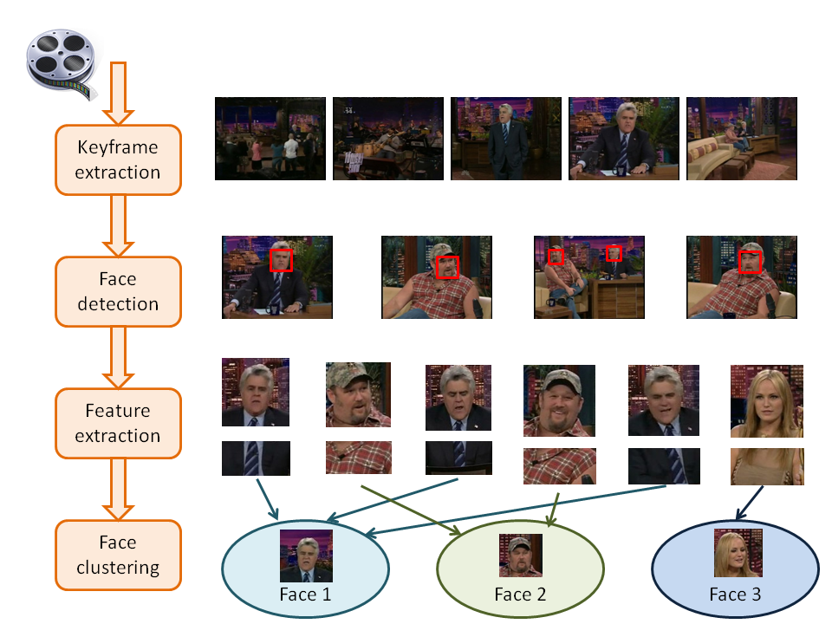
Face Clustering

Slide 11
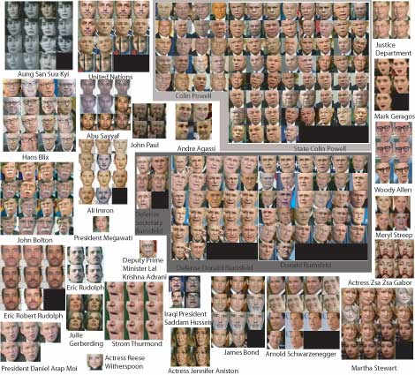
Face clustering

Slide 12
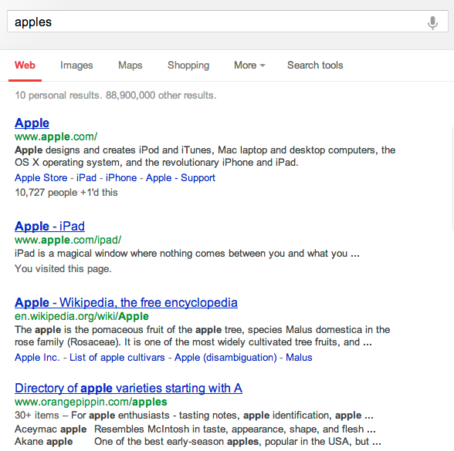
Search result clustering

Slide 13
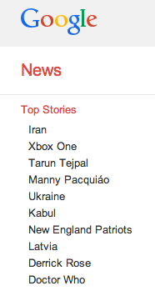
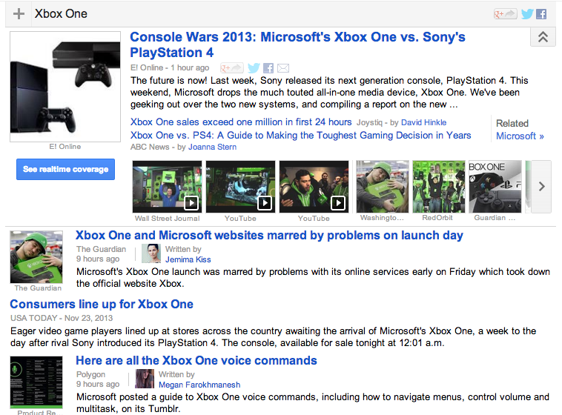
Google News

Slide 14
Clustering in search advertising
Find clusters of advertisers and keywords
Keyword suggestion
Performance estimation
bids
Advertiser
Bidded Keyword
~10M nodes

Slide 15
Clustering applications
Find clusters of users
Targeted advertising
Exploratory analysis
Clusters of the Web Graph
Distributed pagerank computation
Who-messages-who IM/text/twitter graph
~100M nodes

Slide 16
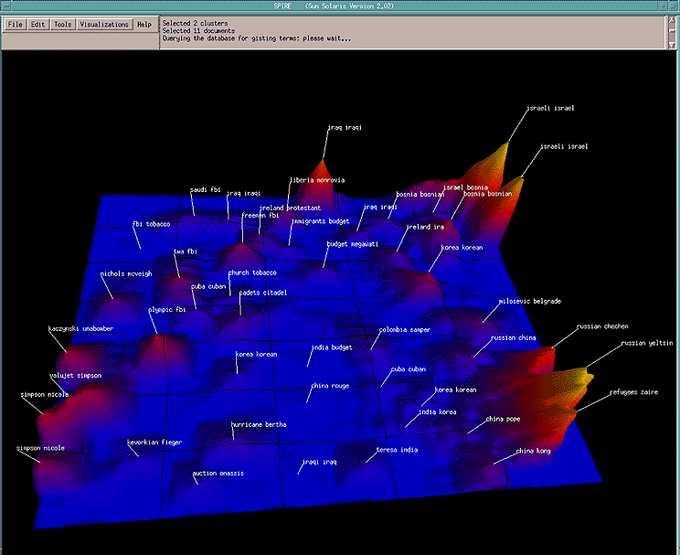
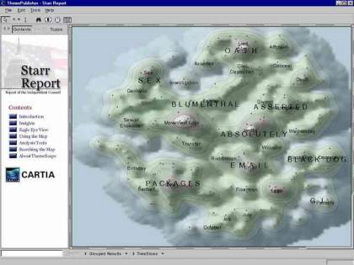
Data visualization
Wise et al, “Visualizing the non-visual” PNNL
ThemeScapes, Cartia
[Mountain height = cluster size]

Slide 17
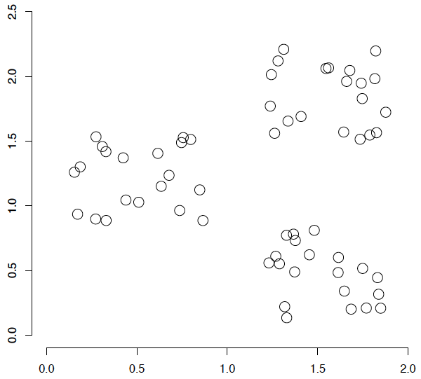
A data set with clear cluster structure
What are some of the issues for clustering?
What clustering algorithms have you seen/used?

Slide 18
Issues for clustering
Representation for clustering
How do we represent an example
features, etc.
Similarity/distance between examples
Flat clustering or hierarchical
Number of clusters
Fixed a priori
Data driven?

Slide 19
Clustering Algorithms
Flat algorithms
Usually start with a random (partial) partitioning
Refine it iteratively
K means clustering
Model based clustering
Spectral clustering
Hierarchical algorithms
Bottom-up, agglomerative
Top-down, divisive

Slide 20
Hard vs. soft clustering
Hard clustering: Each example belongs to exactly one cluster
Soft clustering: An example can belong to more than one cluster (probabilistic)
Makes more sense for applications like creating browsable hierarchies
You may want to put a pair of sneakers in two clusters: (i) sports apparel and (ii) shoes

Slide 21
K-means
Most well-known and popular clustering algorithm:
Start with some initial cluster centers
Iterate:
Assign/cluster each example to closest center
Recalculate centers as the mean of the points in a cluster

Slide 22
K-means: an example

Slide 23
K-means: Initialize centers randomly

Slide 24
K-means: assign points to nearest center

Slide 25
K-means: readjust centers

Slide 26
K-means: assign points to nearest center

Slide 27
K-means: readjust centers

Slide 28
K-means: assign points to nearest center

Slide 29
K-means: readjust centers

Slide 30
K-means: assign points to nearest center
No changes: Done

Slide 31
K-means
Iterate:
Assign/cluster each example to closest center
Recalculate centers as the mean of the points in a cluster
How do we do this?

Slide 32
K-means
Iterate:
Assign/cluster each example to closest center
Recalculate centers as the mean of the points in a cluster
iterate over each point:
- get distance to each cluster center
- assign to closest center (hard cluster)

Slide 33
K-means
Iterate:
Assign/cluster each example to closest center
Recalculate centers as the mean of the points in a cluster
iterate over each point:
- get distance to each cluster center
- assign to closest center (hard cluster)
What distance measure should we use?

Slide 34
Distance measures
Euclidean:
good for spatial data

Slide 35
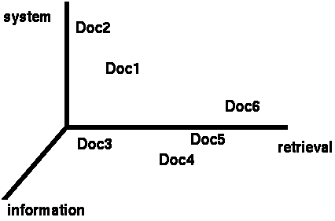
Clustering documents (e.g. wine data)
One feature for each word. The value is the number of times that word occurs.
Documents are points or vectors in this space

Slide 36
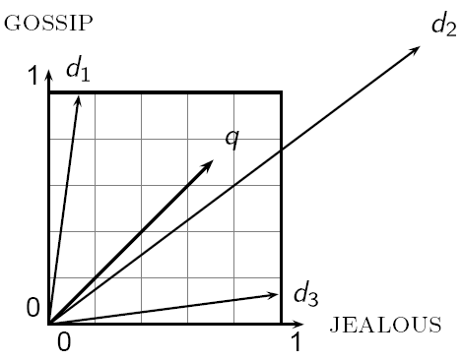
When Euclidean distance doesn’t work
Which document is closest to q using Euclidian distance?
Which do you think should be closer?

Slide 37
Issues with Euclidian distance
the Euclidean distance between q and d₂ is large
but, the distribution of terms in the query q and the distribution of terms in the document d₂ are very similar
This is not what we want!

Slide 38
cosine similarity
correlated with the angle between two vectors

Slide 39
cosine distance
cosine similarity is a similarity between 0 and 1
- things that are similar = 1
- things that are not similar = 0
We want a distance measure, cosine distance:
good for text data and many other “real world” data sets
is computationally friendly since we only need to consider features that have non-zero values in both examples

Slide 40
K-means
Iterate:
Assign/cluster each example to closest center
Recalculate centers as the mean of the points in a cluster
Where are the cluster centers?

Slide 41
K-means
Iterate:
Assign/cluster each example to closest center
Recalculate centers as the mean of the points in a cluster
How do we calculate these?

Slide 42
K-means
Iterate:
Assign/cluster each example to closest center
Recalculate centers as the mean of the points in a cluster
Mean of the points in the cluster:
where:

Slide 43
K-means loss function
K-means tries to minimize what is called the “k-means” loss function:
that is, the sum of the squared distances from each point to the associated cluster center

Slide 44
Minimizing k-means loss
Iterate:
1. Assign/cluster each example to closest center
2. Recalculate centers as the mean of the points in a cluster
Does each step of k-means move towards reducing this loss function (or at least not increasing)?

Slide 45
Minimizing k-means loss
Iterate:
1. Assign/cluster each example to closest center
2. Recalculate centers as the mean of the points in a cluster
This isn’t quite a complete proof/argument, but:
Any other assignment would end up in a larger loss
The mean of a set of values minimizes the squared error

Slide 46
Minimizing k-means loss
Iterate:
1. Assign/cluster each example to closest center
2. Recalculate centers as the mean of the points in a cluster
Does this mean that k-means will always find the minimum loss/clustering?

Slide 47
Minimizing k-means loss
Iterate:
1. Assign/cluster each example to closest center
2. Recalculate centers as the mean of the points in a cluster
NO! It will find a minimum.
Unfortunately, the k-means loss function is generally not convex and for most problems has many, many minima
We’re only guaranteed to find one of them

Slide 48
K-means variations/parameters
Start with some initial cluster centers
Iterate:
Assign/cluster each example to closest center
Recalculate centers as the mean of the points in a cluster
What are some other variations/parameters we haven’t specified?

Slide 49
K-means variations/parameters
Initial (seed) cluster centers
Convergence
A fixed number of iterations
partitions unchanged
Cluster centers don’t change
K!

Slide 50
K-means: Initialize centers randomly
What would happen here?
Seed selection ideas?

Slide 51
Seed choice
Results can vary drastically based on random seed selection
Some seeds can result in poor convergence rate, or convergence to sub-optimal clusters
Common heuristics
Random centers in the space
Randomly pick examples
Points least similar to any existing center (furthest centers heuristic)
Try out multiple starting points
Initialize with the results of another clustering method

Slide 52
Furthest centers heuristic
μ₁ = pick random point
for i = 2 to K:
μ_{i} = point that is furthest from any previous centers
point with the largest distance to any previous center
smallest distance from x to any previous center

Slide 53
K-means: Initialize furthest from centers
Pick a random point for the first center

Slide 54
K-means: Initialize furthest from centers
What point will be chosen next?

Slide 55
K-means: Initialize furthest from centers
Furthest point from center
What point will be chosen next?

Slide 56
K-means: Initialize furthest from centers
Furthest point from center
What point will be chosen next?

Slide 57
K-means: Initialize furthest from centers
Furthest point from center
Any issues/concerns with this approach?

Slide 58
Furthest points concerns
If k = 4, which points will get chosen?

Slide 59
Furthest points concerns
If we do a number of trials, will we get different centers?
Notes:
yes and no
we will get different centers, but the three outliers will always get chosen!

Slide 60
Furthest points concerns
Doesn’t deal well with outliers

Slide 61
K-means++
μ₁ = pick random point
for k = 2 to K:
for i = 1 to N:
s_{i} = min d(x_{i}, μ_{1…k-1}) // smallest distance to any center
μ_{k} = randomly pick point x_{i} with a probability proportional to s_{i}²
How does this help?

Slide 62
K-means++
μ₁ = pick random point
for k = 2 to K:
for i = 1 to N:
s_{i} = min d(x_{i}, μ_{1…k-1}) // smallest distance to any center
μ_{k} = randomly pick point x_{i} with a probability proportional to s_{i}²
Makes it possible to select other points
if #points >> #outliers, we will pick good points
Makes it non-deterministic, which will help with random runs
Nice theoretical guarantees!

Slide 63
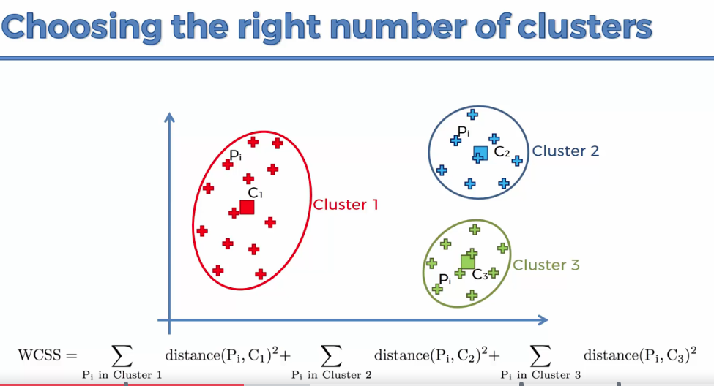

Slide 64
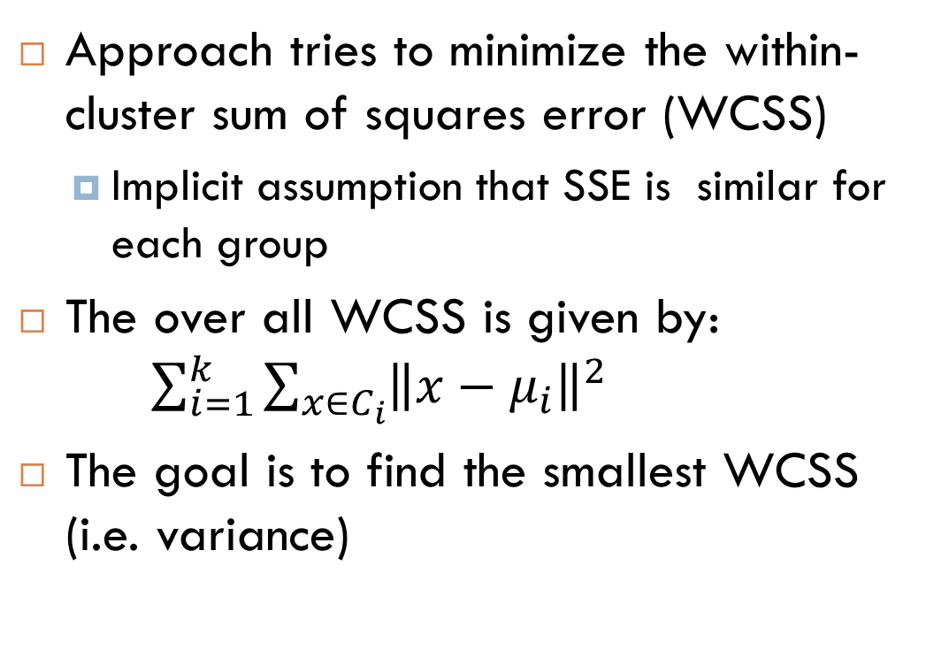
Choosing the right K
Approach tries to minimize the within-cluster sum of squares error (WCSS)
Implicit assumption that SSE is similar for each group
The over all WCSS is given by: $\sum_{i=1}^{k}{\sum_{x∈C_{i}}{{\left\|x−μ_{i}\right\|}^{2}}}$
The goal is to find the smallest WCSS (i.e. variance)

